Slide 1
#HelpUsSayYes Webinar: Civil restoration process: Civil applications
LAA teams
November 2025

Slide 2


Technical tips for this webinar
You can ask us questions throughout the event using the ‘meeting chat’​
You can keep the meeting chat throughout the event to view other questions​
Email us if you experience technical issues during the webinar:
LAAHelpUsSayYes@justice.gov.uk
Camera and audio off when icons appear like this:
Click on the chat bubble icon to view the meeting chat
Notes:
Questions in chat – if you see a question in the chat which you would like to know the answer to, please give it a thumbs up. This will save you from typing a similar question and the questions with the higher # of thumbs up will be answered at the end. All questions will be compiled onto a Q&A document and sent out to you in due course and will be uploaded onto the LAA website
Standalone recording – will be uploaded onto the website – the link will be published in the weekly email.
Limit your questions to client and cost management system (CCMS) – if you have any billing questions we won’t be able to answer them in the call but they will be in the Q&A document.
We are also scheduling billing Q&A sessions as part of the restoration process. Please check the weekly email for further information.
Survey – will be sent in an email after Thursdays event – Email will also include other useful guidance.

Slide 3
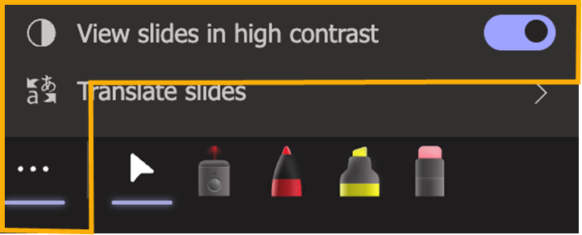
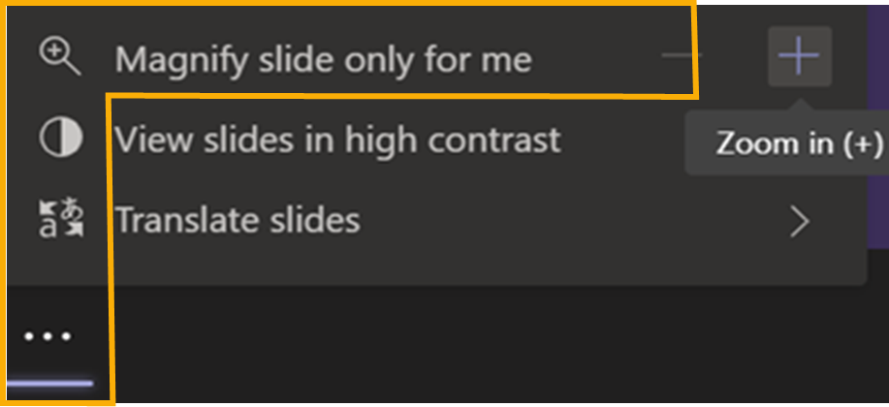
PowerPoint live: Option 1
High contrast:
Select more options > View slides in high contrast.
Magnify:
Select more options > Magnify slide only for me.

Slide 4
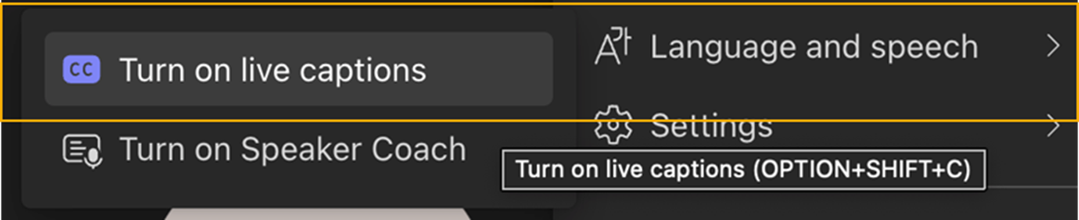
PowerPoint live: Option 2
Captions:
Language and speech > Turn on live captions

Slide 5
Restoration process: Civil applications
The purpose of this webinar is to provide:
An overall update on progress
Information and guidance on key topics
Time for Q&A
Topic | Speaker
Latest progress | Samera Aslam
Secure browser | Tim Broomfield
Phased onboarding and case reassignment | Sean Wardale
Q&A and wrap up | All

Slide 6
Latest progress

Slide 7
Civil restoration: Progress to date
The team have been working hard to restore the Client and Cost Management System (CCMS) after the incident
CCMS is now available via a secure browser, with new login processes being introduced
Testing and phased onboarding are underway to ensure system stability and security
Teams have collaborated across departments and made progress processing contingency applications
More work remains, and preparations for continued recovery are ongoing
October 25
November 2025
December 2025
Internal tests
External trial and test
Onboarding
Internal business acceptance testing & manual data entry from contingency applications
w/c 10 Nov: Assisted Live Trial
w/c 17 Nov: Business acceptance testing
w/c 24 Nov: Phased onboarding begins

Slide 8
Amazon web services (AWS) - Secure browser

Slide 9

Secure Browser approach
Provider access to CCMS will be via a Secure Browser:
This will be the only possible way to gain access to CCMS
Multi Factor Authentication (MFA) enforced for every session.
What is it?
AWS ‘WorkSpaces’ Secure Browser is a fully managed, cloud-native browser isolation service.
This means:
No sensitive data (HTML, DOM, files) ever touches your device.
The browsing environment is disposable and isolated in AWS for each individual session.
Access to the service is limited to external users with certain CCMS profile attributes.
These permissions are granted within the ‘Sign into Legal Aid Services’ (SiLAS) application.
It works with your existing IT— no software install required or VPN overlay.
Notes:
The why - As part of our ongoing commitment to improving digital security, we have implemented an additional layer of authentication for users accessing CCMS, once the system becomes available. To strengthen access controls, users will now be required to complete a two-step authentication process. After logging in via Sign in to Legal Aid Services (SiLAS) and selecting CCMS, users will be redirected to a Secure Browser login page where they must enter their username and password.

Slide 10

What does this mean?
The Secure Browser feature provides CCMS with significantly enhanced security measures. This means:
Your data is isolated on a per session basis: No local caching or downloads, with Policy enforcement as required.
The Service is integrated with MoJ’s identity platform: Configured to also require MFA
Scalable: Serverless architecture can scale and be used to prevent over-loading MoJ internal systems given enhanced security monitoring is also in place.
Helps ensure we meet strict data protection and compliance requirements and prevents data leakage with ‘one user, one account’ being the underlying principle.

Slide 11
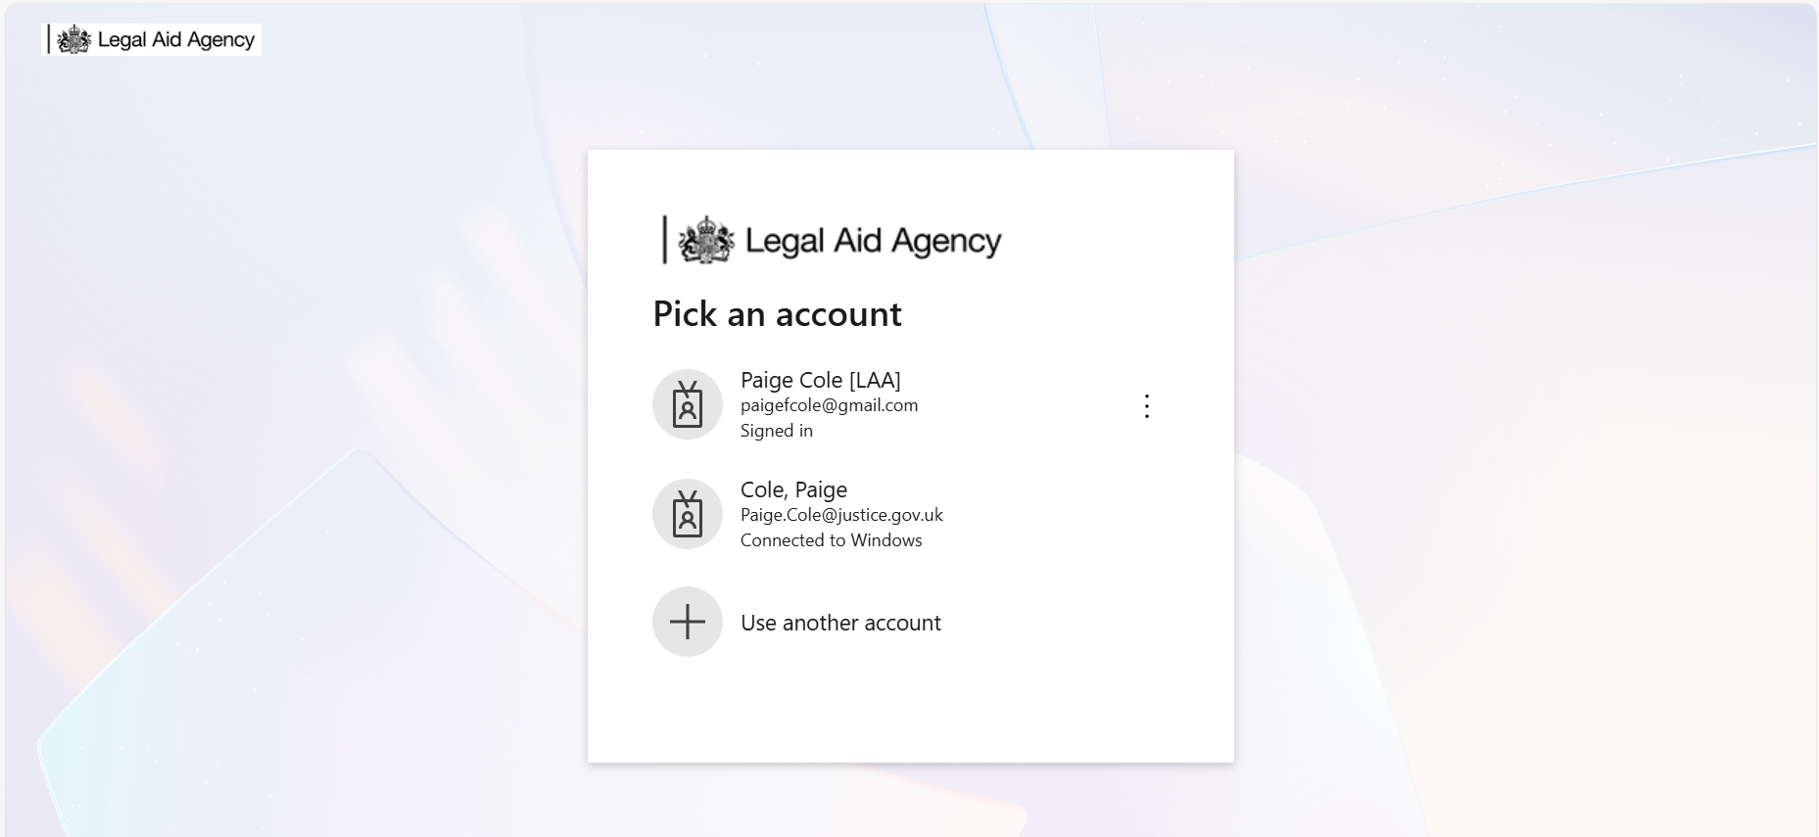
1
When you navigate to the SiLAS page link, you will be prompted via a pop-up box to select the account with which you wish to login with.
If your organisation uses Corporate Microsoft services, select your Corporate credentials you are logged in with
<email address>
If your organisation uses other email services (eg Gmail, Yahoo, other) then use them
<email address>

Slide 12
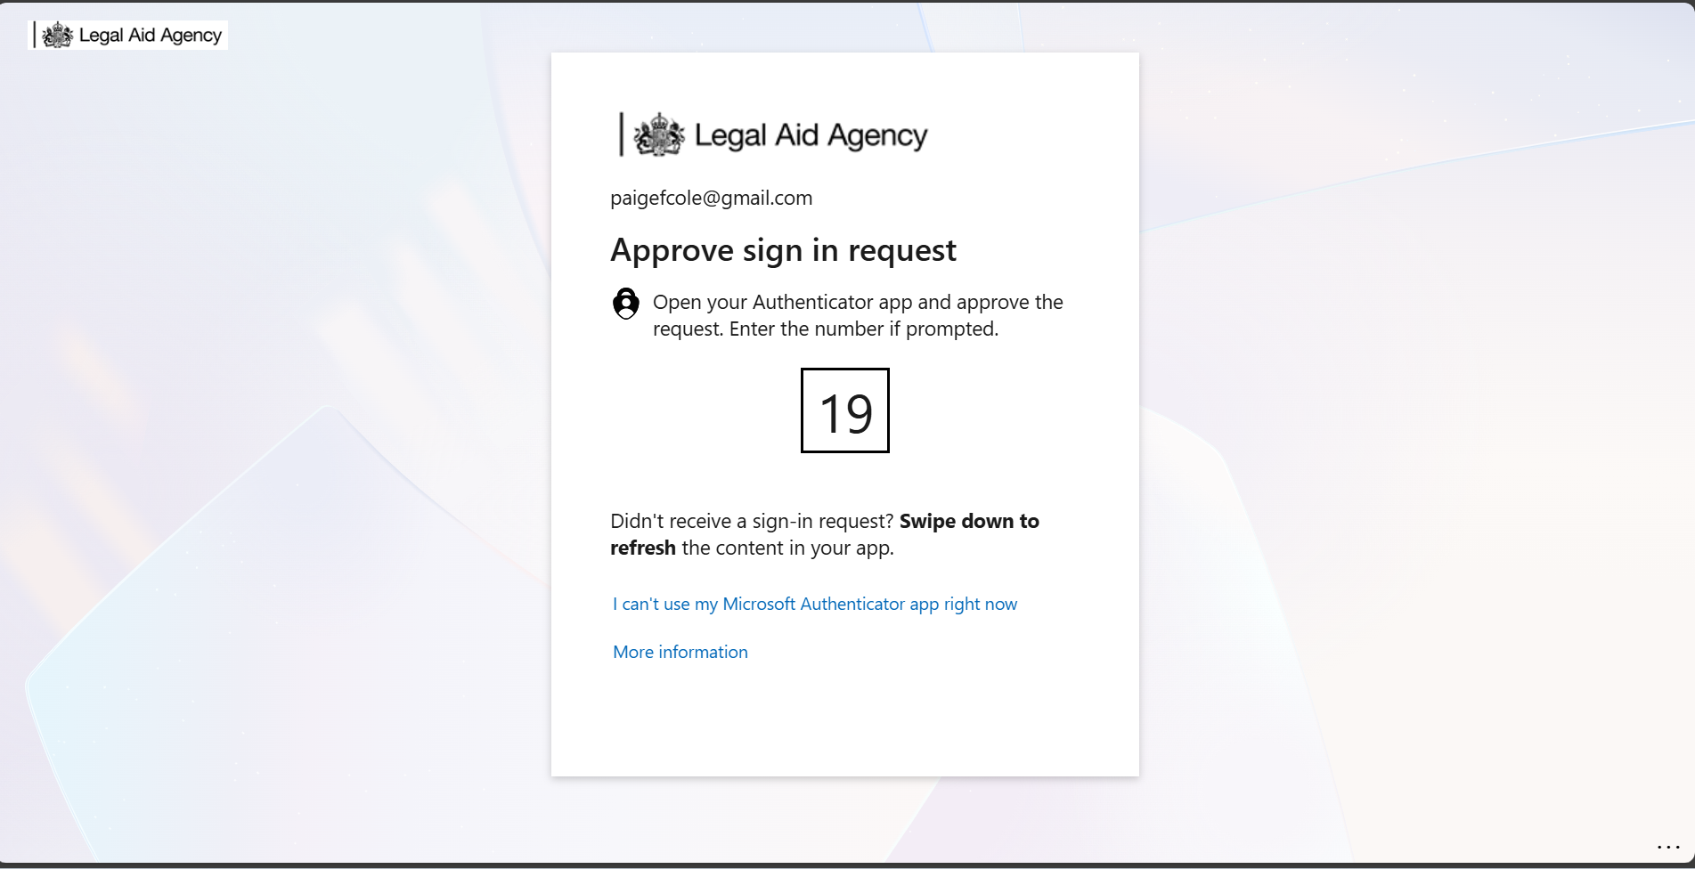
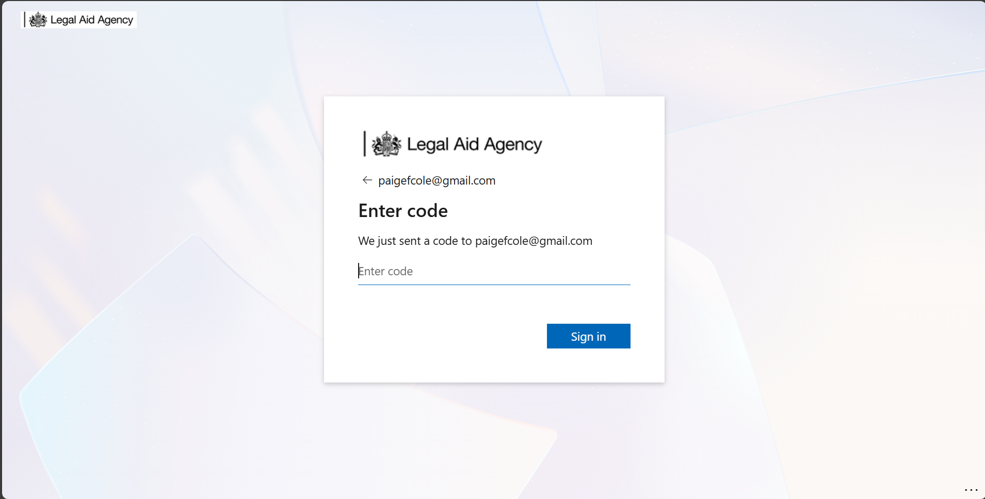
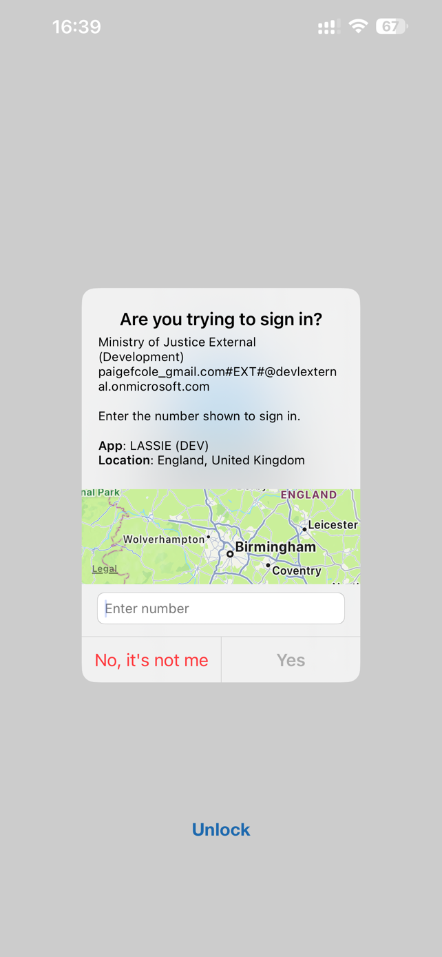
1a
Non-Microsoft users only
2
<email address>
<email address>
<email address>
<email address>
If your organisation uses web-based email services (e.g Gmail, Yahoo or other) you will get sent a unique one-time passcode (OTP) via email, enter it here
Note: Microsoft users will skip step 1a as you have ‘logged in’ to your corporate systems and considered as ‘authenticated’.
You are required to re-authenticate via a smartphone app, SMS, or voice call, depending on how you set your MFA,
to progress to MoJ systems.

Slide 13
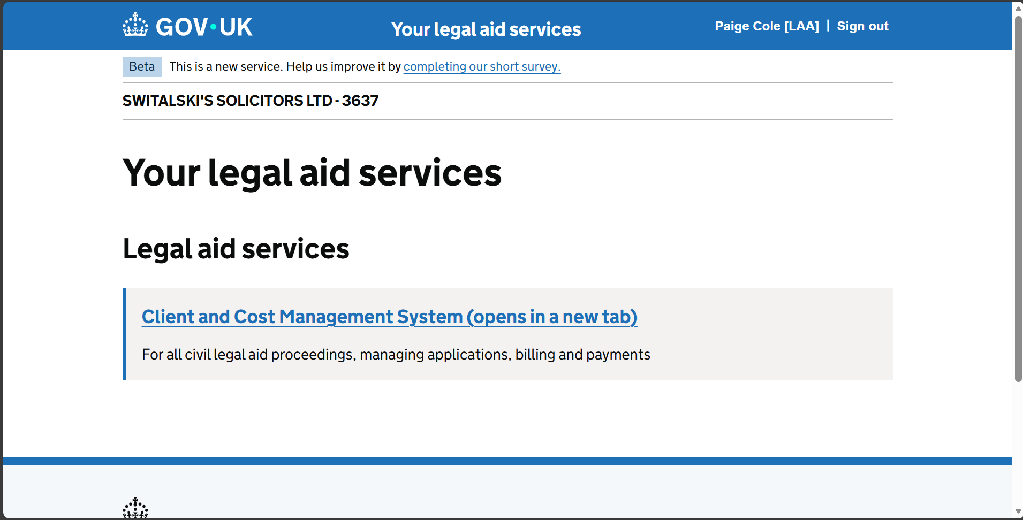
3
If your user profile has been granted permissions to multiple LAA applications, they will be listed here on the SiLAS home page once you are logged in
<Username>
<FIRM NAME> - <FIRM ID>

Slide 14
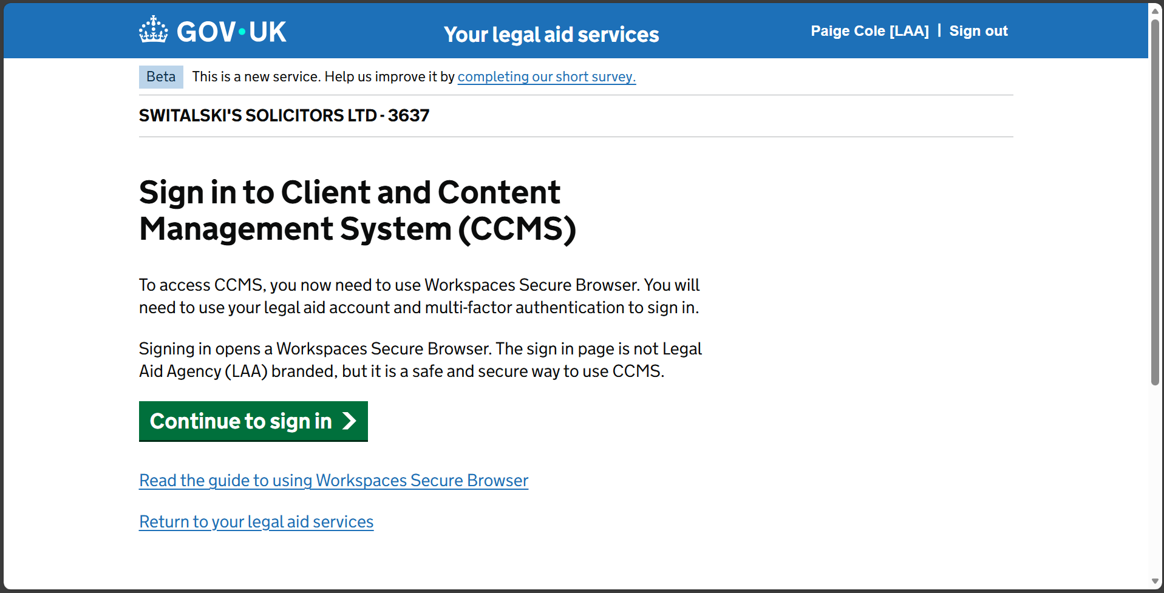
4
!
!
We have entered an additional information page informing users the next step will take them to a non Gov.UK branded page.
This remains within the MoJ infrastructure, but we have no ability to brand it.
<Username>
<FIRM NAME> - <FIRM ID>

Slide 15
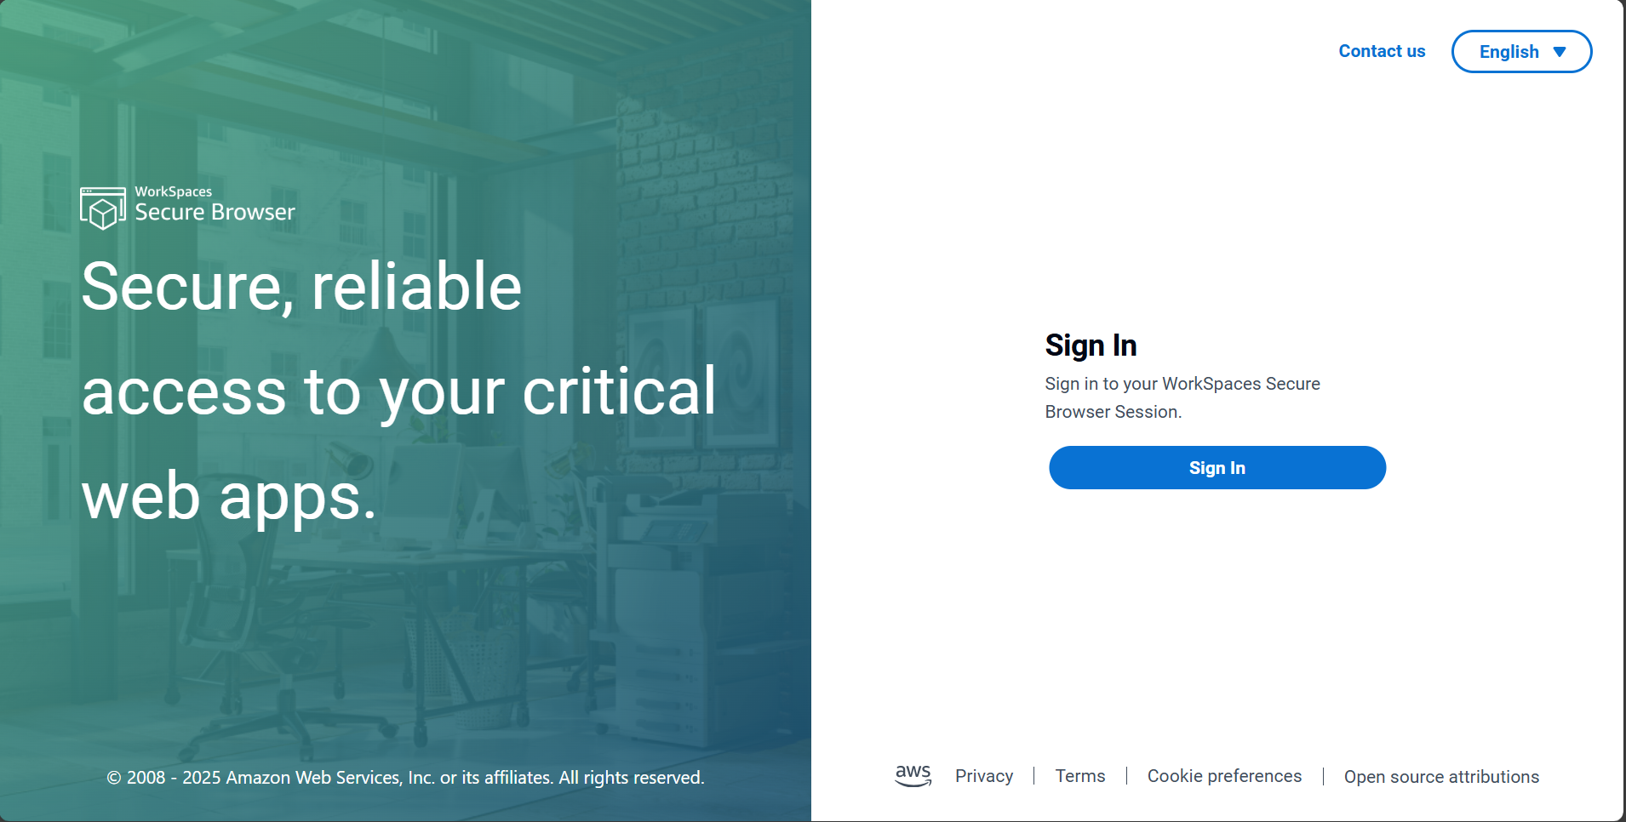
5
This is the AWS Secure Browser tab that will launch, given its virtual nature, you will have to reauthenticate by signing in once more.

Slide 16
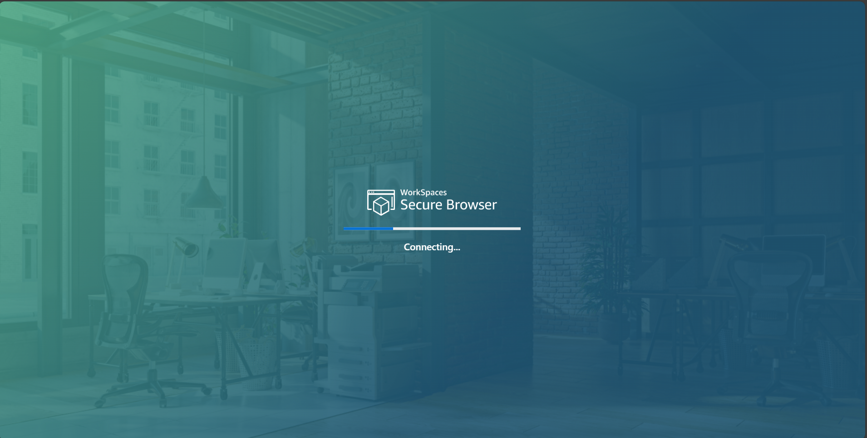
6
You will have to re-select the user profile you wish to login with (as step 1):
Depending on your corporate infrastructure, then 1a (if applicable)
Finally another re-authentication (as step 2) which will present the loading screen below:

Slide 17
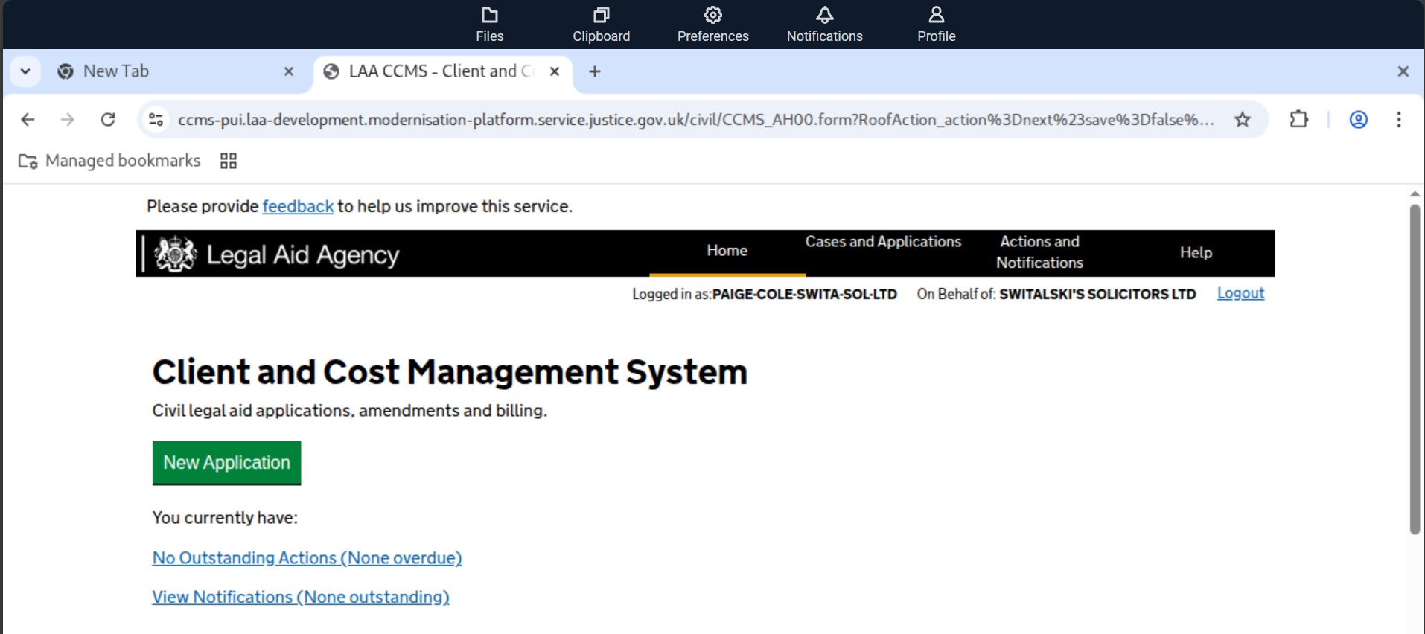
7
Once the Secure Browser session is loaded, you will be in CCMS and can progress with work as required
<username>
<Firm>

Slide 18
Phased onboarding

Slide 19

Why are we taking a phased approach?
Our approach is designed to safeguard system stability, manage risk, and ensure a smooth transition for all users and providers.
System stability and risk management: A phased approach prevents overload and supports stability by gradually increasing user numbers after an outage.
Data-driven decisions: User access is scaled up in stages based on real-time performance monitoring and feedback.
Controlled rollout of functionality: Features and access are incrementally restored to minimise risk and enable targeted troubleshooting.
Provider communication and expectation management: Providers & users receive clear, timely updates about changes, and any arising issues.
Business continuity: Decision points in the rollout allow for quick reversion or pauses if problems emerge to limit disruption.
Mitigating support overload: Managing user volume helps keep support requests at manageable levels during restoration.
Notes:
As we progress with the restoration of our service platform following the recent outage, I want to outline the principles and expectations underpinning our phased approach.
Our approach is designed to safeguard system stability, manage risk, and ensure a smooth transition for all users and providers.
1. System Stability and Risk Management We are implementing a staged reintroduction of users to prevent system overload and maintain platform stability. By controlling the pace of access, we reduce the risk of total system failure and ensure the platform remains secure as user numbers increase.
2. Data-Driven Decisions At each phase, we will monitor system performance and user experience closely. Decisions to scale up or pause will be based on real-time data and technical feedback, allowing us to respond proactively to any emerging issues.
3. Controlled Rollout of Functionality Initial access will be limited in both user numbers and available features (e.g., new applications and essential case linking only). Full functionality will be restored only after the system demonstrates it can handle increased demand, enabling targeted troubleshooting and risk reduction.
4. Provider Communication and Expectation Management Clear, honest communication with providers is central to our approach. We will set expectations about phased access and provide timely updates if targets are not met or issues arise. This transparency is essential to maintaining trust and minimizing reputational risk.
5. Business Continuity Should any issues arise, the phased approach provides defined decision points to revert to previous business continuity processes or pause the rollout. This minimises disruption for both providers and end users.
6. Mitigating Support Overload By controlling user numbers and activity scope, we can better manage support desk volumes and avoid overwhelming support channels during the initial restoration period.

Slide 20
The phased onboarding approach to CCMS
Access to CCMS will need to be controlled through concurrent session management & functionality through user roles available
This is to avoid system overload during onboarding and once the full user base has access
18 Nov – 21 Nov 25
Mon 24 Nov
Tues 25 Nov
Wed 26 Nov
Thurs 27 Nov & Fri 28 Nov
Mon 1 Dec
Business Acceptance Testing
Day 1
Day 2
Day 3
Day 4 & 5
Day 6
A small number of providers to complete external user testing
Runs for 4 days
Tues & Wed (Supervised)
Thurs & Fri (Unsupervised)
Provider Users ~30 to 40
Release to holders of both Crime & Civil contracts.
From Day 1:
CCMS PUI limited to non-billing roles
Provider admins can assign roles to users
CCMS PUI limited to 1000 concurrent users
Civil Apply Live: no restrictions
If stable,
remaining CCMS roles are released for provider admins to assign.
Third-party users (such as Cost Lawyers, Cost Drafters, barristers & barristers clerks) invited to complete registration.
Increase concurrent user limit for PUI up to 2000 concurrent users.
If stable,
Increase concurrent user limit for PUI up to 6000 concurrent users.
If stable,
Release to Civil Only Providers, CCMS PUI and Civil Apply.
Provider admins can assign roles to users.
Continue to assess concurrent user limit for PUI.
CCMS, PUI & Civil Apply service accessible: 07:00 – 21:30, 7 days per week
Users may experience limited access as we monitor system health and expand capacity
Notes:
Service restoration will begin with a Business Acceptance Testing (BAT) phase, where a small group of users will be granted access to ensure the system is stable and functioning as expected.
Following successful BAT, we will implement a phased go-live approach, gradually increasing the number of users who can access the system each day to manage demand and maintain performance.
During this period, you may experience limited access as we carefully monitor system health and expand capacity.
We will communicate updates regularly and inform you when you are able to access the service, ensuring a safe and reliable restoration for all users.
Step through the slide covering the key points.

Slide 21
Case reassignment

Slide 22
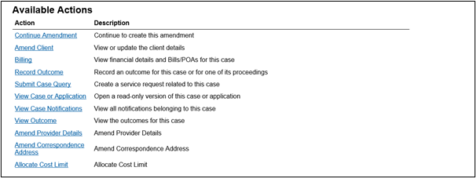
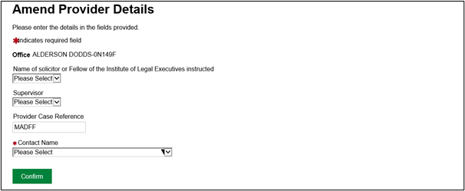
Case reassignment process
When you access CCMS, you may need to reassign some cases to continue receiving actions and notifications:
Use ‘Case and Application’ search to locate any cases submitted under your old account.
From available actions: Select ‘Amend Provider Details’
Amend the ‘Contact Name’ on each case to your new SiLAS account:
Prioritise amendments for live cases and those requiring bill submissions.
Note: Prior to ‘go-live’ - Joining instructions will be shared with guidance and screenshots
Notes:
Amend Provider Details – Legal Aid Learning

Slide 23
Q&A

Slide 24
What comes next
After this session:
We will send follow up questions with written responses
A recording of this session and slides will be shared
We ask for your feedback of the session via a survey
How we plan to support:
Training Website
Guidance
Upcoming CCMS training sessions across December (sign up via Eventbrite)
Civil Billing Seminars (including withdrawal from average payment scheme) coming up w/c 1st December
Weekly representative body meetings led by deputy director David Phillips
Civil process efficiency team (PET) meetings will resume normal schedule
An ask from us:
Please prioritise reading communications that will be provided for key information

Slide 25
Support available
If you have a technical query / need support, email us: online-support@justice.gov.uk
General LAA query: Contact civil customer service team: 0300 200 2020
Your contract manager

Slide 26
General additional information

Slide 27

Our training website
Online Support Webchat
Use webchat for help with IT system issues: Legal Aid Learning
Webinar Recordings
Our ‘Help Us Say Yes’ webinars focus on areas where there have been issues or high enquiry levels
Popular sessions are posted on the training website: Ministry of Justice and the LAA YouTube channel: Legal Aid Agency youtube channel. Remember to like and subscribe!

Slide 28
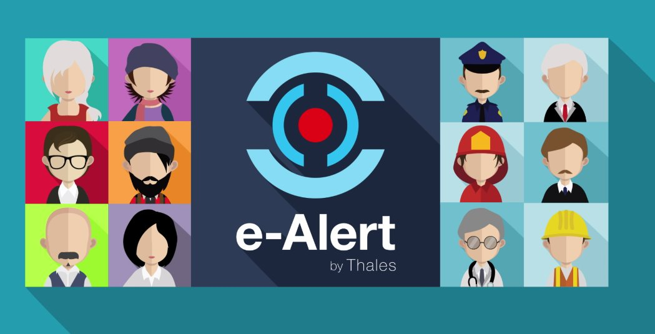

Useful links for additional information
Legal Aid Bulletin
Social Media
A fortnightly e-alert with links to relevant pages
Follow us on X (formerly Twitter)
Join our thousands of subscribers: Sign-up to LAA Bulletin >>
Read our blog
Get help from our customer service twitter account

Slide 29

Legal Aid Agency​ 13th Floor (13.51)​ 102 Petty France​ London SW1H 9AJ​
gov.uk/government/organisations/legal-aid-agency

